Slide 1
Agile Process
Prepared By:
Deepthi G

Slide 2
Agile Process
Is driven by customer descriptions of what is required
Develops software iteratively with a heavy emphasis on construction activities
Adopts as changes occur
Project is divided into many parts

Slide 3
Characteristics of Agile Team
Common focus
Collaboration
Fuzzy problem solving ability
Mutual trust and respect
Self organization

Slide 4
Scrum
Small working teams are organized to maximize communication, sharing of ideas, minimize overhead.
Features:
- Testing and documentation are on-going as the product is constructed
- scrum incorporates the following activities: Requirements, Analysis, Design, Evolution and delivery
- Work within activities occurs in ‘sprints’ and is derived from a ‘backlog’ of existing requirements

Slide 5
Backlog:
A prioritized list of project requirements or features
Items can be added to the backlog at any time
Sprints:
Consists of work units that are required to achieve a requirement

Slide 6
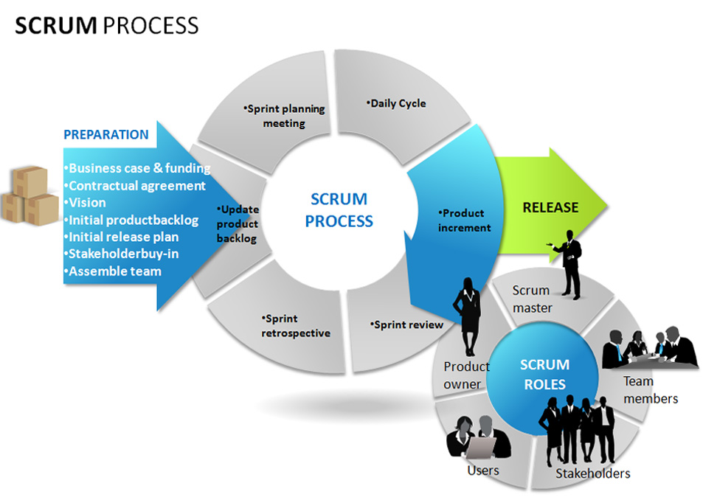

Slide 7
Scrum meeting:
Short meeting held daily by the scrum team.
Three key questions are asked and answered by all team members
Team leader is called as scrum master

Slide 8
Thank you

